Slide 1
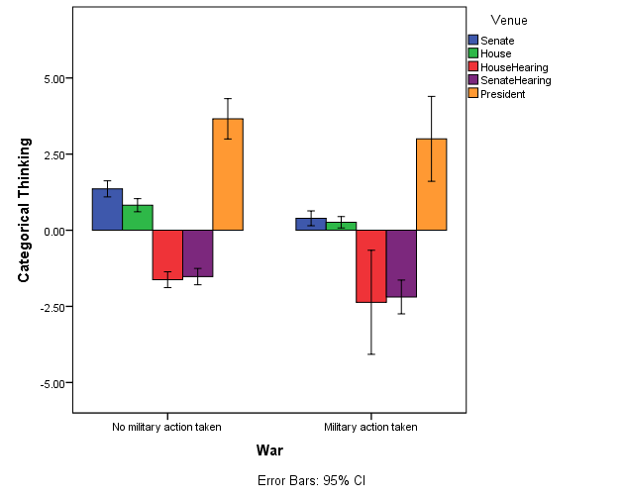
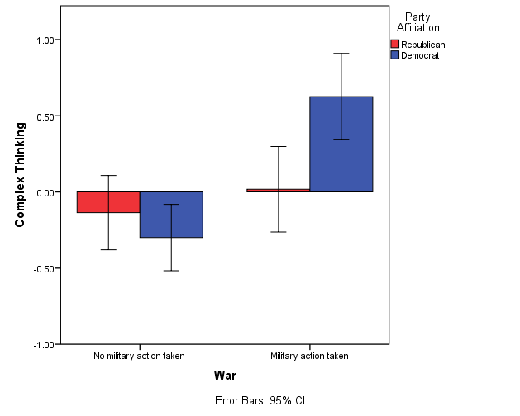
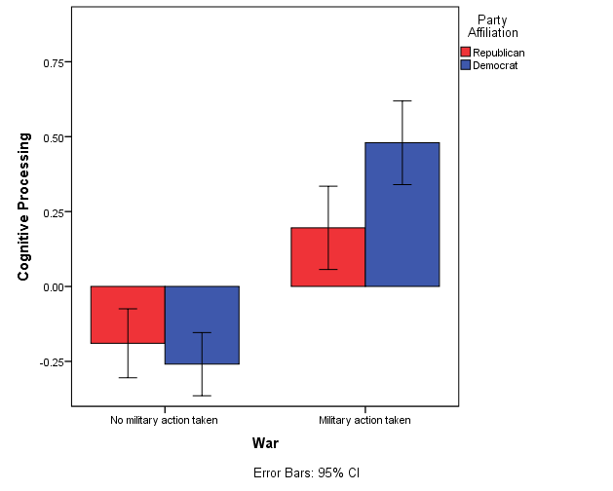
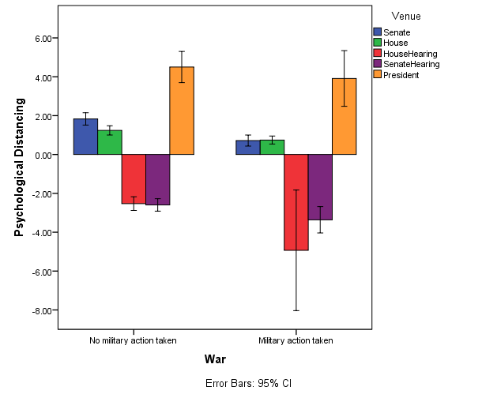
Political Party Differences in Discourse on Conflict
Kayla N. Jordan, Erin M. Buchanan, and Jahnavi R. Delmonico
Missouri State University
Introduction
The political map of the U.S. is painted blue and red. Hence, it is important to understand how these party differences influence decisions which impact millions of people. Some of the most important decisions are those of war and peace which affect not only Americans but also people of other nations. The purpose of the present study is to examine the relationships between party affiliations, foreign policy decisions, and language in U.S. politicians.
Party Differences in Language
Political and group words such as citizen or constitution (Jarvis, 2007).
Use of moral words such as harm or just (Graham, Haidt, & Nosek, 2009).
Presidential and depressive language (Slatcher, Chung, Pennebaker, &Stone, 2007) .
Foreign Policy and Language
Third person singular pronouns (Jordan & Buchanan, under review).
Us versus them distinctions (Leudar, Marsland, & Nekvapil, 2004).
Results
Table 2 Individual Predictors
Model | Predictors | B | SE | t | p | 95% CI |  | r²
Categorical Thinking | Intercept | .130 | .885 | .15 | .889 | -1.973 | 2.295
 | Party | .431 | .184 | 2.34 | .020 | .070 | .794 | <.01
 | War | -.673 | .154 | -4.36 | <.001 | -.976 | -.370 | .02
 | Party * War | -.036 | .201 | -.18 | .857 | -.430 | .358 | .01
Complex Thinking | Intercept | -.175 | .497 | -.35 | .738 | -1.388 | .971
 | Party | -.040 | .217 | -.19 | .852 | -.465 | .386 | <.01
 | War | .756 | .204 | 3.70 | <.001 | .355 | 1.158 | .03
 | Party * War | .654 | .267 | 2.45 | .014 | .129 | 1.178 | .02
Cognitive Processing | Intercept | -.179 | .200 | -.90 | .405 | -.664 | .275
 | Party | -.021 | .102 | -.21 | .837 | -.221 | .179 | <.01
 | War | .627 | .100 | 6.26 | <.001 | .430 | .823 | .05
 | Party * War | .330 | .131 | 2.53 | .012 | .074 | .586 | .04
Psychological Distancing | Intercept | .096 | 1.278 | .08 | .943 | -2.949 | 3.198
 | Party | .335 | .220 | 1.52 | .128 | -.097 | .796 | <.01
 | War | -.628 | .184 | -3.41 | <.001 | -.988 | -.267 | .02
 | Party * War | -.119 | .239 | -.50 | .619 | -.589 | .351 | .01
Categorical Thinking
logLik = -4915.52
df = 1696
ΔlogLik = 25.01
Δdf = 3
Critical χ² = 7.82
R² = .02
n =
206
n =
483
n =
373
n =
256
n =
47
n =
251
n =
560
n =
11
n =
55
n =
15
Complex Thinking
n = 423
logLik = -5592.71
df = 1696
ΔlogLik = 34.47
Δdf = 3
Critical χ² = 7.82
R² = .03
n = 653
n = 712
Method
Data: Congress, Foreign Affairs Committee Hearings, Presidential Statements
Time Frame: 1998 to 2013 or to date of Congressional approval of military action.
Predictors: Foreign Policy Decision (No War – Iran, North Korea, Russia, Libya, Sudan, Syria; War – Iraq, Afghanistan, Kosovo) & Party Affiliation (Republican, Democrat)
Outcomes: Metalinguistic constructs
n = 470
n=55
Cognitive Processing
Construct | Formula | Reference
Categorical thinking | articles + prepositions + big words – verbs | Pennebaker (2011)
Complex thinking | exclusive + conjunctions + words/sentence + negations + insight + cause-inclusive | Pennebaker (2011)
Cognitive processing | insight + causation | Cohn, Mehl, and Pennebaker (2004)
Psychological distancing | articles + big words - I-words – discrepancy – present tense verbs | Cohn et al. (2004)
logLik = -4001.57
df = 1696
ΔlogLik = 68.56
Δdf = 3
Critical χ² = 7.82
R² = .05
Discussion
H₁ was supported. Cognitive processing increased for war discourse with this increase being greater for Democrats. Complex thinking also increases when politicians discuss war decisions with greater increases for Democratic politicians.
H₂ was not supported; however, main effects for war discourse were found. Categorical thinking decreased in war discourse with complex effects for discourse venue. Psychological distancing showed similar trends with distancing decreasing in war discourse.
Venue differences could possibly be explained by differences in the decision making processes. The Foreign Affairs committees are often attempting to craft comprehensive foreign policy whereas Congress and the President typically discuss reactions to specific events such as a missile launch.
Effect sizes, although small, demonstrate the importance of foreign policy decisions to the language used by politicians.
n=206
n = 653
n = 712
n = 423
n = 470
Psychological Distancing
Note. The formulas listed are based on the z scores of the LIWC categories percentage of the document.
Hypotheses
H₁ : An interaction effect for cognitive processing and complex thinking such that levels of these constructs will increases for war discourse with a steeper slope for Democrats.
H₂ : An interaction effect for categorical thinking and psychological distancing such that levels of these constructs will decrease for war discourse with a steeper slope for Republicans.
n =
206
n =
483
n =
373
n =
256
n =
47
n =
251
n =
560
n =
11
n =
55
n =
15
logLik = -5312.36
df = 1696
ΔlogLik = 16.49
Δdf = 3
Critical χ² = 7.82
R² = .02
Contact: Kayla Jordan (kaylajordan91@gmail.com) or Erin Buchanan (erinbuchanan@missouristate.edu), sponsored by Russell N. Carney

